Slide 1
Artificial Neural Networks

Slide 2
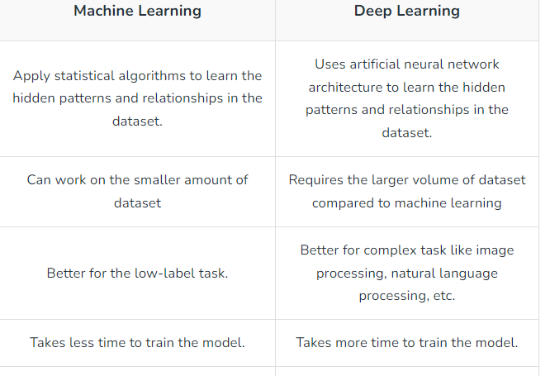

Slide 3
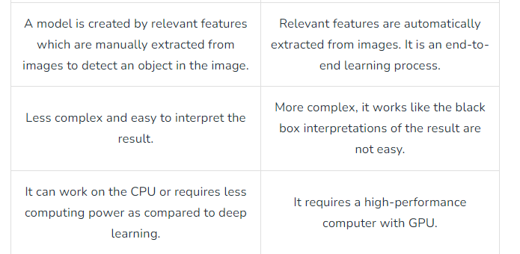

Slide 4
Introduction to deep learning
Deep learning is a branch of machine learning which is based on artificial neural networks to model and solve complex problems.
An artificial neural network or ANN uses layers of interconnected nodes called neurons that work together to process and learn from the input data.
These neural networks are inspired by the structure and function of the human brain’s biological neurons, and they are designed to learn from large amounts of data.

Slide 5
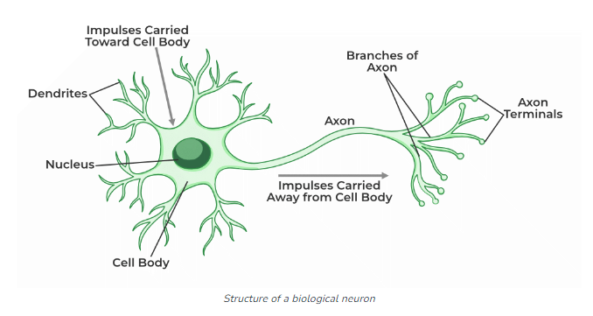

Slide 6
Motivation behind ANN
Replicate some aspects of the brain's neural structure and functioning to create computational models capable of learning, adaptation, and information processing.

Slide 7
Types of Neural Networks:
Feedforward Neural Networks (FNN): Information flows in one direction, from input to output.
Recurrent Neural Networks (RNN): Can retain memory and process sequences.
Convolutional Neural Networks (CNN): Specialized for image data, using convolutional layers.

Slide 8
Feedforward Neural Networks (FNNs):
Architecture: Neurons arranged in layers without cycles or loops between neurons.
Information Flow: Information moves in a single direction, from input to output layers.
Typical Usage: Excellent for tabular data, structured data, and tasks where sequential information or temporal dependencies are less critical.

Slide 9
Feedforward Neural Networks (FNNs):
Appropriate problems:
Image and Text Classification: Recognizing objects in images, sentiment analysis in text.
Regression Tasks: Predicting house prices based on features, sales forecasting.
Pattern Recognition: Handwriting recognition, fraud detection in transactions.

Slide 10
Recurrent Neural Networks (RNNs):
Architecture: Contains cyclic connections between neurons, enabling feedback loops.
Information Processing: Retains memory and can handle sequential/temporal data, processing inputs while considering past context.
Typical Usage: Ideal for sequential data, time-series data, natural language processing (NLP), speech recognition, and tasks requiring memory or context.

Slide 11
Recurrent Neural Networks (RNNs):
Appropriate problems:
Natural Language Processing (NLP): Language translation, chatbots, sentiment analysis.
Time-Series Prediction: Stock market forecasting, weather prediction, IoT data analysis.
Speech Recognition: Voice assistants, speech-to-text conversion, Language modeling

Slide 12
Convolutional Neural Networks (CNNs):
Architecture: Employs convolutional layers for feature extraction, preserving spatial relationships in data (e.g., images).
Feature Extraction: Well-suited for grid-like data such as images, preserving hierarchical spatial information.
Typical Usage: Best for computer vision tasks, image and video analysis, object detection, and tasks requiring translation invariance.
Applications: Image classification, object detection, image segmentation, facial recognition, medical imaging analysis.

Slide 13
Convolutional Neural Networks (CNNs):
Appropriate Problems:
Computer Vision: Object detection, image classification, image segmentation.
Medical Imaging Analysis: Diagnosing diseases from MRI/CT scans, analyzing pathology slides.
Facial Recognition: Biometric security, emotion detection in images/videos.

Slide 14
Artificial Neural Network
Artificial Neural Network (ANN) is a type of neural network that is based on a Feed-Forward strategy.
It is called this because they pass information through the nodes continuously till it reaches the output node.

Slide 15
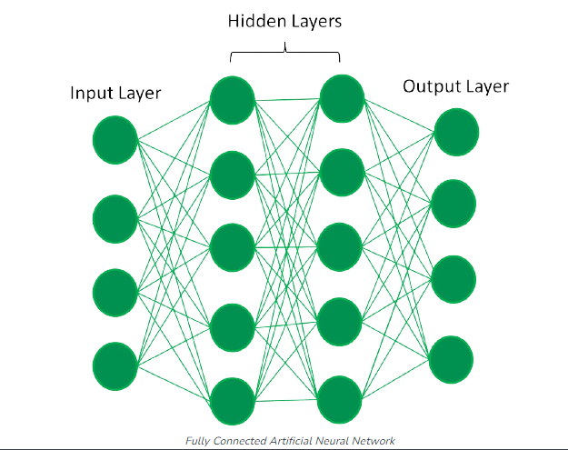
Artificial Neural Network

Slide 16
Building Blocks of Neural Networks:
Input Layer: Receives the input data.
Hidden Layers: Layers between input and output layers where complex patterns are learned.
Output Layer: Produces the network's predictions.

Slide 17
Understanding Neural Networks Basics:
Neurons: The basic units of a neural network, which mimic the functionality of biological neurons.
Layers: Neurons are organized in layers—input layer, hidden layers, and output layer.
Weights and Bias: Parameters that the network learns during training to make predictions.
Activation Functions: Functions applied to neurons' weighted sum to introduce non-linearity (e.g., ReLU, Sigmoid, Tanh).

Slide 18
Appropriate problems for neural network learning
training data is noisy, complex sensor data
instances are attribute-value pairs, attributes may be highly correlated or independent, values can be any real value
target function may be discrete-valued, real-valued or a vector
training examples may contain errors
long training times are acceptable
requires fast eval. of learned target function.
humans do NOT need to understand the learned target function.

Slide 19
Perceptron
Proposed by Frank Rosenblatt in 1957 at Cornell Aeronautical Laboratory, it was one of the earliest forms of neural networks used for supervised learning tasks.
fundamental building block of artificial neural networks (ANNs)
mathematical model of a biological neuron.
It is a binary classifier that takes multiple binary inputs and produces a single binary output.

Slide 20
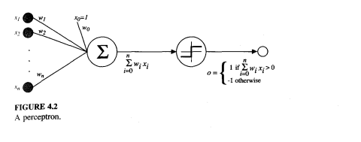

Representation:
A perceptron takes a vector of real-valued inputs, calculates a linear combination of these inputs, then outputs a 1 if the result is greater than some threshold and -1 otherwise

Slide 21
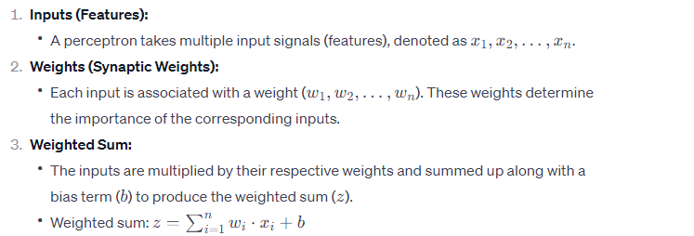
Key Components of a Perceptron:

Slide 22
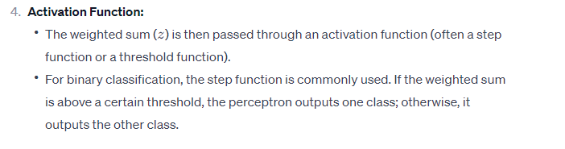
Key Components of a Perceptron:

Slide 23
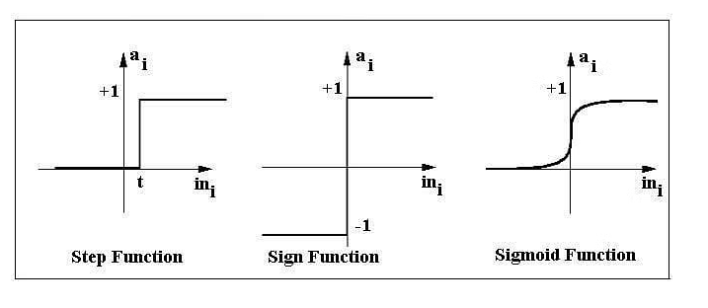
Activation Functions of Perceptron

Slide 24
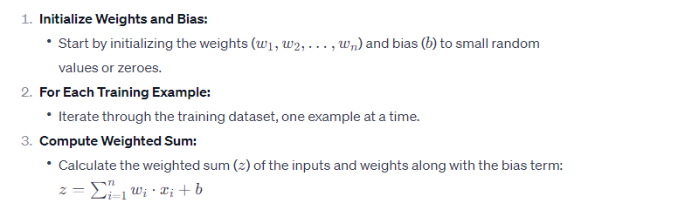
Perceptron Training Rule Steps:

Slide 25
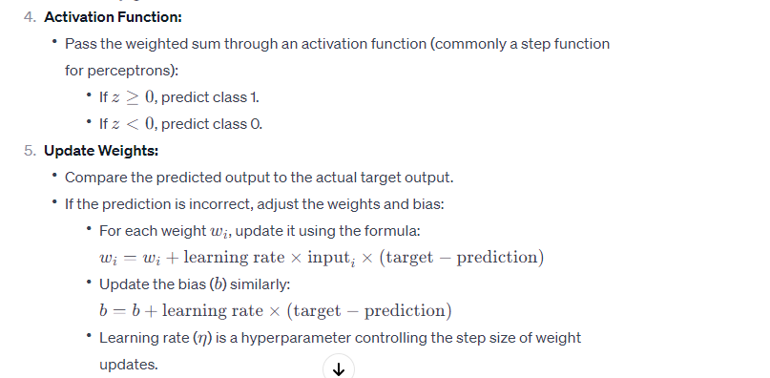


Slide 26
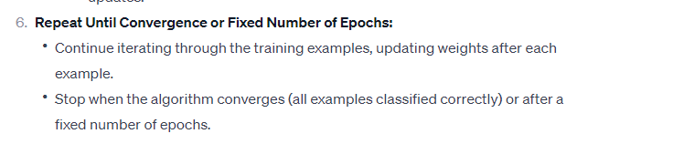

Slide 27
Epoch
Suppose you have a dataset of 1,000 examples, and you choose a batch size of 100. To complete one epoch, the model will perform 10 iterations (1,000 examples / 100 examples per batch = 10 batches).
After processing these 10 batches, one epoch will be completed.

Slide 28
Limitations:
The perceptron learning rule is only applicable to linearly separable data.
It cannot solve problems that are not linearly separable, like the XOR problem.

Slide 29
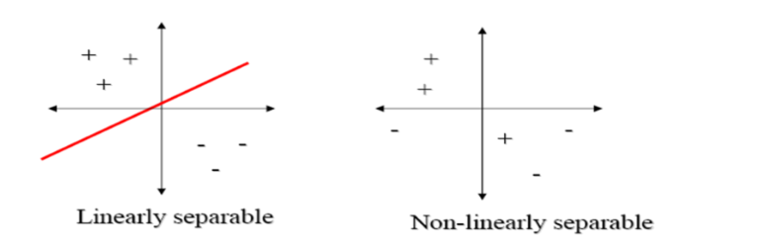

Slide 30
Gradient descent and the Delta rule
Gradient Descent is known as one of the most commonly used optimization algorithms to train machine learning models by means of minimizing errors between actual and expected results.
Perceptron rule finds a weight vector when the training examples are linearly separable.
The key idea behind the delta rule is to use gradient descent to search the hypothesis space of possible weight vectors to find the weights that best fit the training examples.
Gradient descent provides a basis of backpropogation algorithm, which can learn networks with many interconnected units.

Slide 31
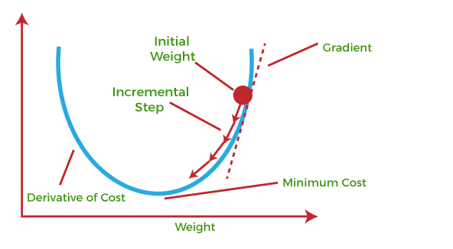
This is a convex curve. It has a single global minimum. So, where ever we initialize any point we can use the gradients to reach the global minimum.
If we consider the points as our weights and the curve as the loss function, we can easily converge to the minimum of the loss function using the derivative of the loss function with respect to weights.
loss
Error Function with one weight

Slide 32
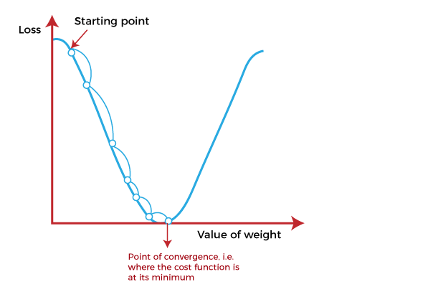

Slide 33
The main objective of using a gradient descent algorithm is to minimize the cost function using iteration.
To achieve this goal, it performs two steps iteratively:
Calculates the first-order derivative of the function to compute the gradient or slope of that function.
Move away from the direction of the gradient, which means slope increased from the current point by alpha times, where Alpha is defined as Learning Rate. It is a tuning parameter in the optimization process which helps to decide the length of the steps.

Slide 34

Derivation of Delta Rule using Gradient Descent
The delta training rule is best understood by considering the task of training an unthresholded perceptron; that is, a linear unit for which the output o is given by
Thus, a linear unit corresponds to the first stage of a perceptron, without the threshold.

Slide 35

In order to derive a weight learning rule for linear units, let us begin by specifying a measure for the training error of a hypothesis (weight vector), relative to the training examples.
Although there are many ways to define this error, one common measure is
where D is the set of training examples, ‘td’ is the target output for training example ‘d’, and od is the output of the linear unit for training example ‘d’.

Slide 36
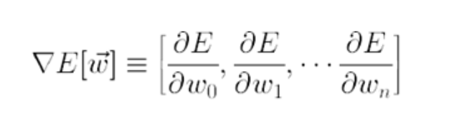
The vector derivative of gradient E is represented as

Slide 37
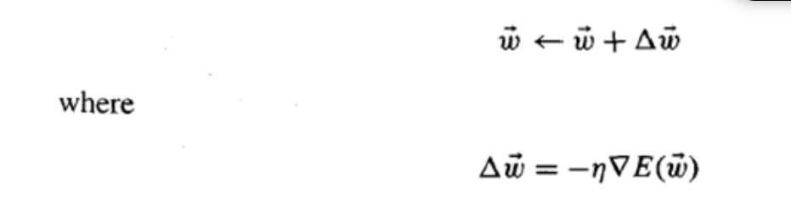
The gradient specifies the direction of steepest increase of E, the training rule for gradient descent is
Here η is a positive constant called the learning rate, which determines the step size in the gradient descent search.

Slide 38
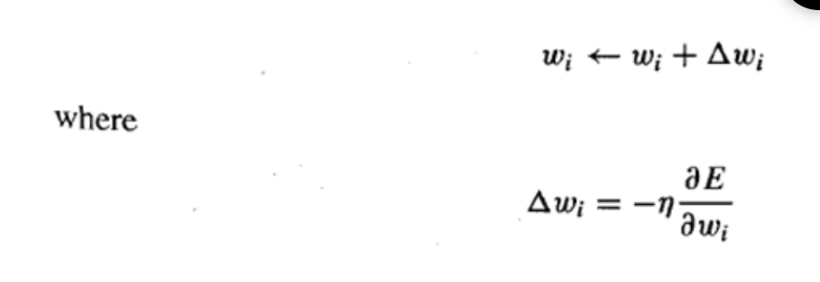
This training rule can also be written in its component form,

Slide 39
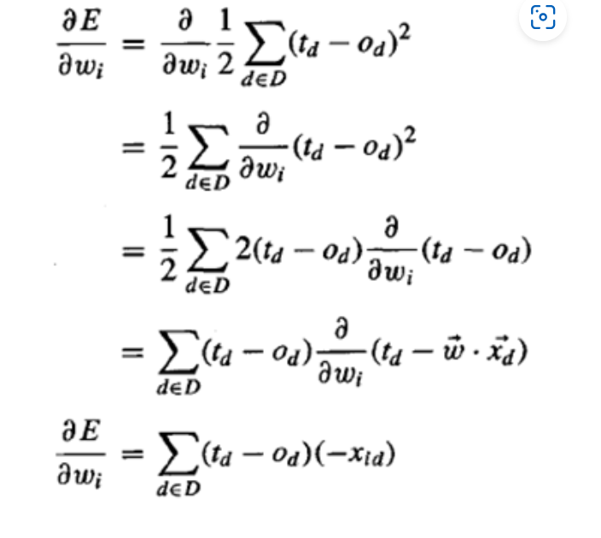

Slide 40
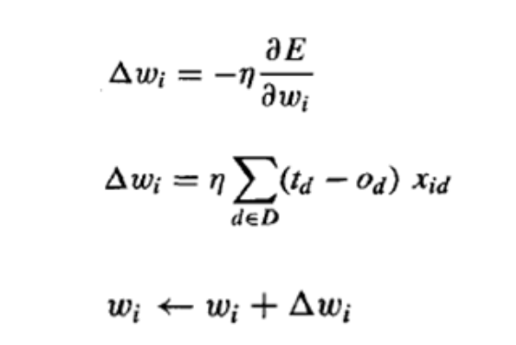
Finally..

Slide 41
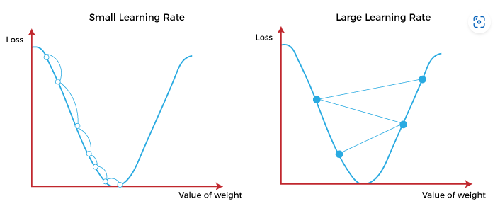
Learning Rate

Slide 42
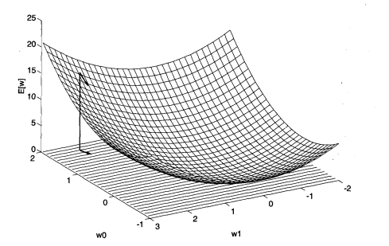
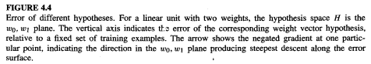
Visualizing the hypothesis space

